Slide 1
JAVA PROJECT BATCH
GUI Programming
Lecture 4

Slide 2
Table Of Contents
01.
Swing Programming in Java
02.
Introduction
03.
04.
JFrame class
Exercises

Slide 3


Developing Swing Programming
The “JFrame” Class: Just like we have Frame class in awt similarly we have the
JFrame class in swing.
As usual we use the JFrame class to create the main window of our application.

Slide 4
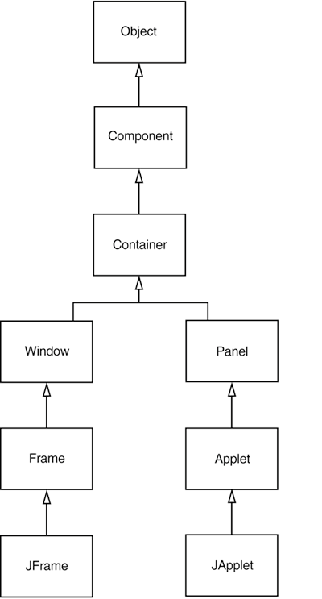
Inheritance Hierarchy Of JFrame

Slide 5
The “JFrame” class
Constructors of “JFrame”:
public JFrame()
public JFrame(String title)
Method of “JFrame” class:
All methods of “JFrame” + some more methods
public void setIconImage(Image)
public void setDefaultCloseOperation(int)
Arguments which can be passed to setDefaultCloseOperation() method:
JFrame.EXIT_ON_CLOSE
JFrame.DO_NOTHING_ON_CLOSE
JFrame.DISPOSE_ON_CLOSE
JFrame.HIDE_ON_CLOSE

Slide 6
Example
Develop a JFrame based application to create a JFrame of 400*400 size with your name displayed in the title bar
Solution:-
import javax.swing.*;
import java.awt.*;
class UseJFrame
{
public static void main(String [] args)
{
jframe jf=new JFrame(“Sachin’s JFrame”);
jf.setSize(400,400);
jf.setVisible(true);
jf.setDefaultCloseOperation(Jframe.EXIT_ON_CLOSE);
}
}

Slide 7
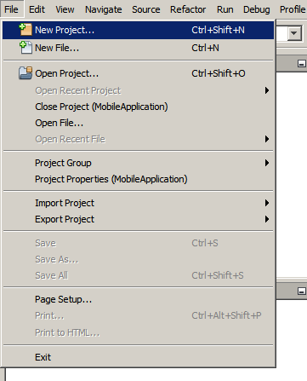
Creating GUI Using GUI Builder
To create an IDE project:
1. Start NetBeans IDE.
2. In the IDE, choose File > New Project, as shown in the figure below.

Slide 8
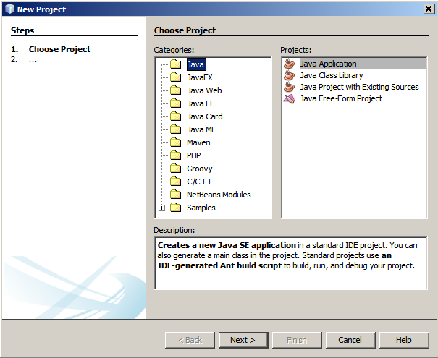
Creating GUI Using GUI Builder
3. In the New Project wizard, expand the Java category and select Java Application as shown in the figure below. Then click Next.

Slide 9
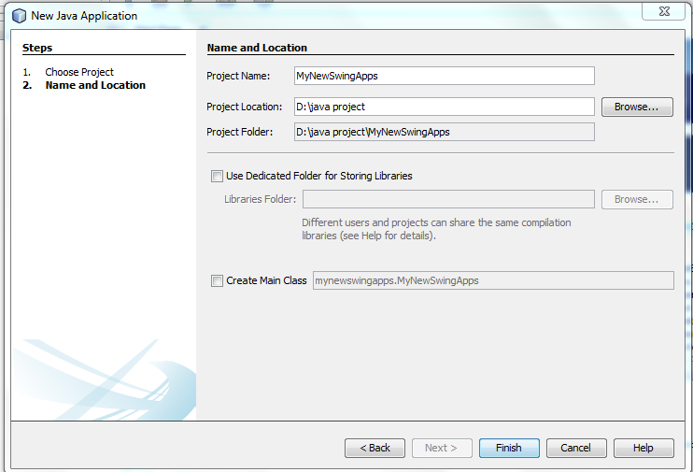
Creating GUI Using GUI Builder
4. In the Name and Location page of the wizard, do the following (as shown in the figure below):
In the Project Name field, type MyNewSwingApps.
Save it in D drive by creating a folder name as java project,Project Location: D:\java project
Uncheck the Main Class field.
And then click on finish.

Slide 10
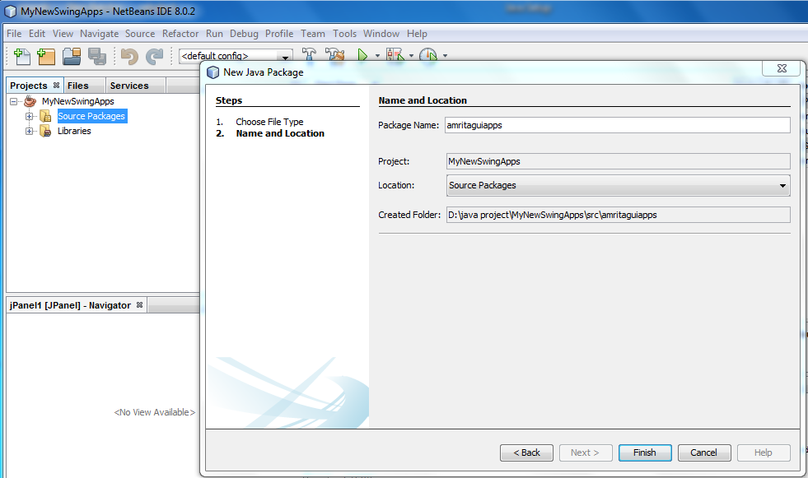
Creating GUI Using GU Builder
5. Now create a package by right clicking on source package, type Package
name: amritaguiapps, then click on finish.

Slide 11
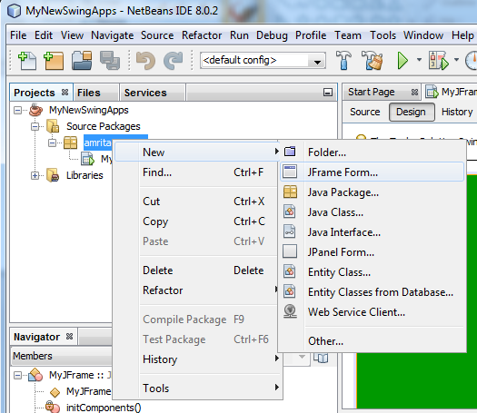
Creating GUI Using GUI Builder
6. Now to create a JFrame right click on source package:
amritaguiapps → New → JFrame Form.

Slide 12
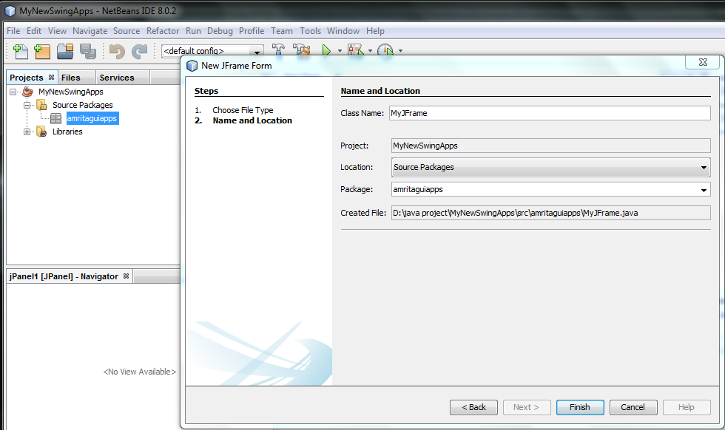
Creating GUI Using GUI Builder
Class Name: MyJFrame then click Finish.

Slide 13
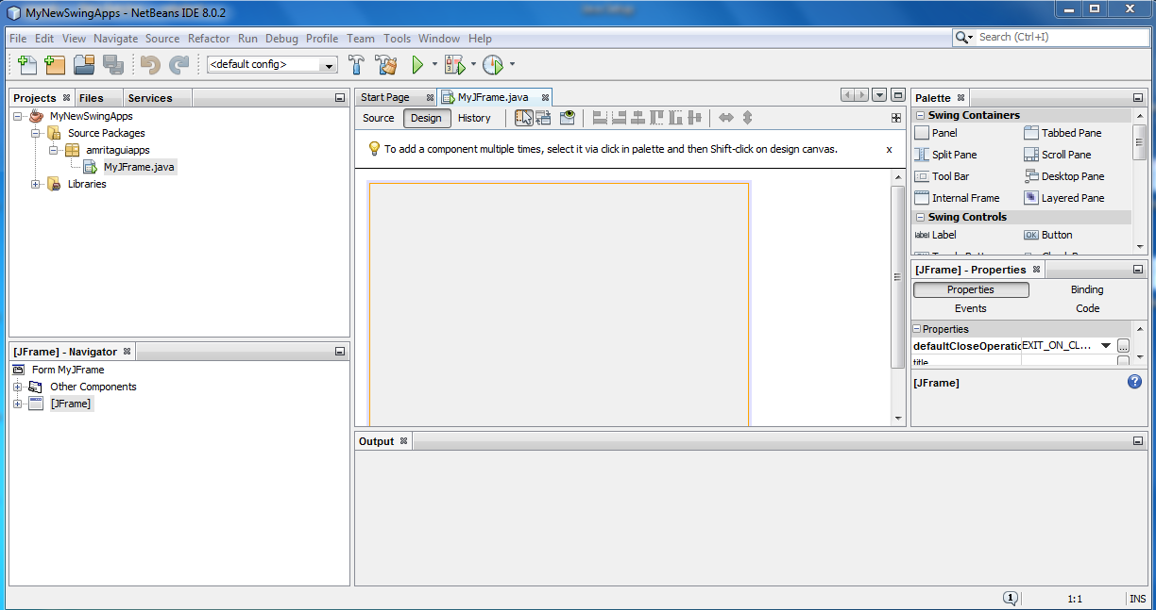
Creating GUI Using GUI Builder
It will look like this:

Slide 14
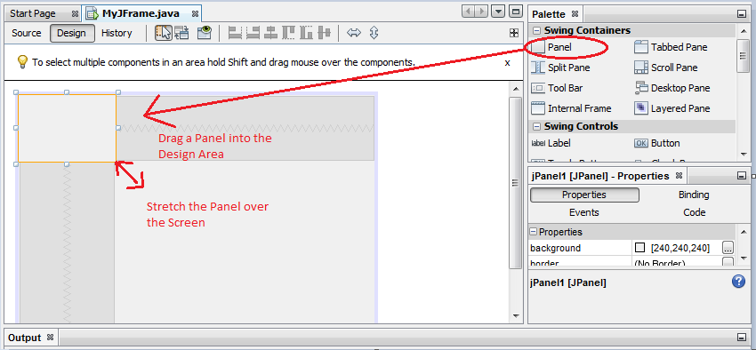
How to Add a Panel to Frames
Adding the Background color is just the matter of few drags and drops. Open the Jframe
windows, drag the Panel from the Palette which is located in the upper right corner to
the Design area.

Slide 15
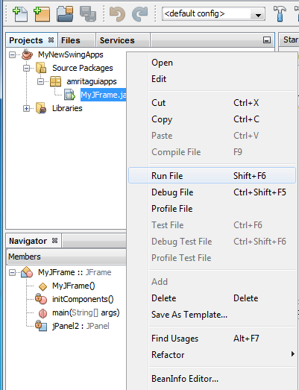
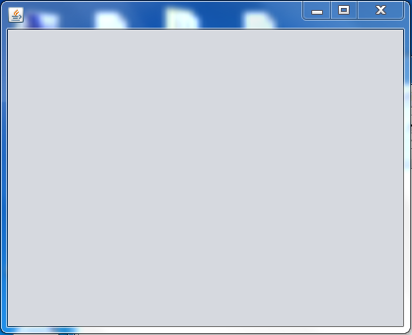
Run the Project
Run the project:
To run the project right click on
Jframe and click on Run File.
After click on Run File the output window look like this.

Slide 16
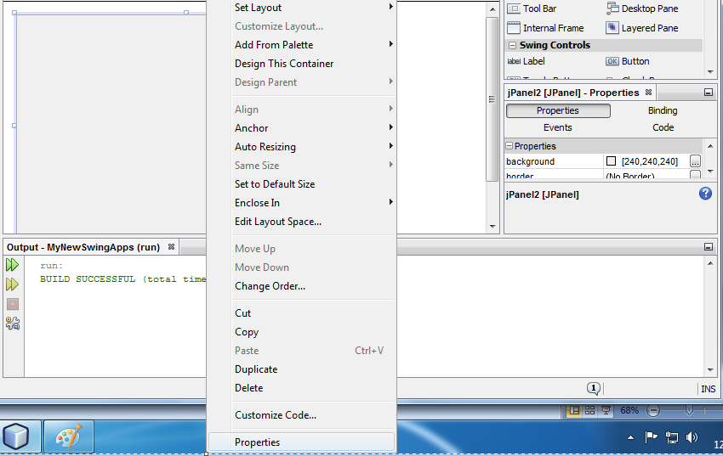
How to add Background Color to JFrame
To add background color of JFrame right click on JFrame, then click on properties as shown below:

Slide 17
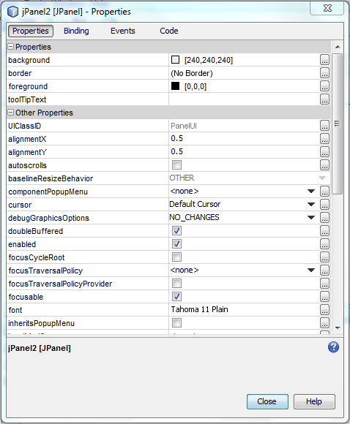
How to add Background Color to JFrame
Now click on Properties → background → Close ,as shown below:

Slide 18
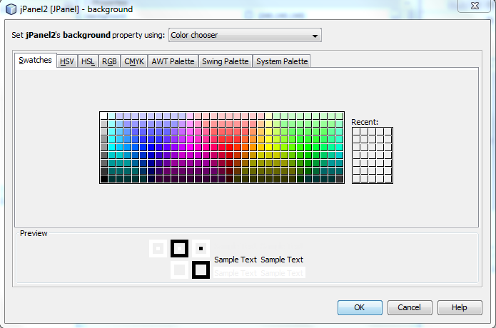
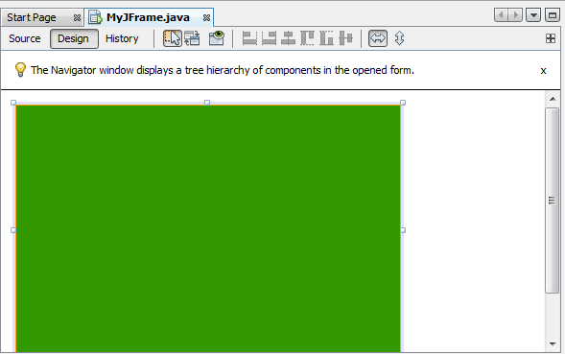
How to add Background Color to JFrame
Choose a color and then click on OK.
Finally it look like this:

Slide 19
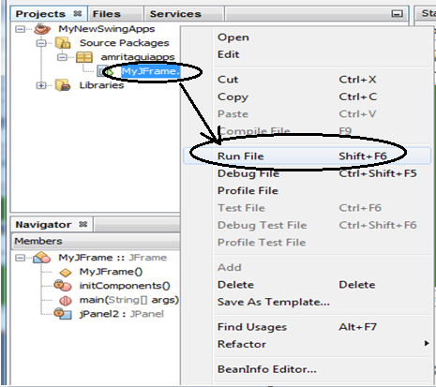
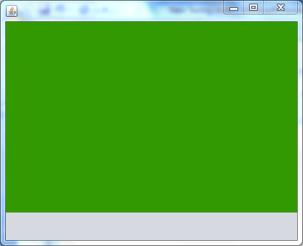
How to add Background Color to JFrame
To Run the Project right click on MyJFrame.java then click on Run File, the output look like this :
Output Window

Slide 20


